Slide 1
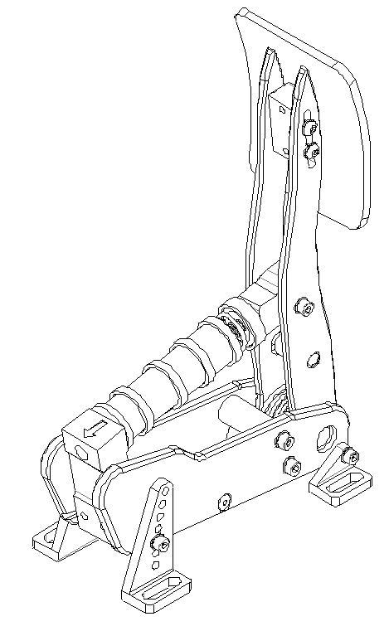
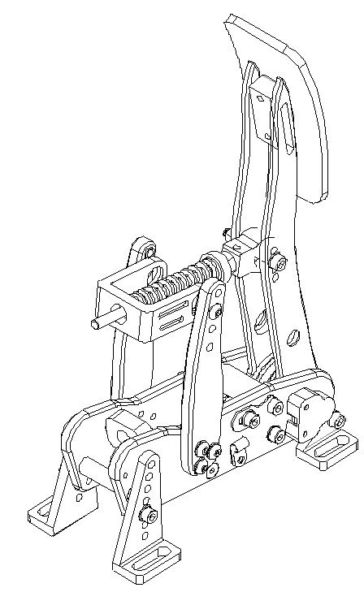
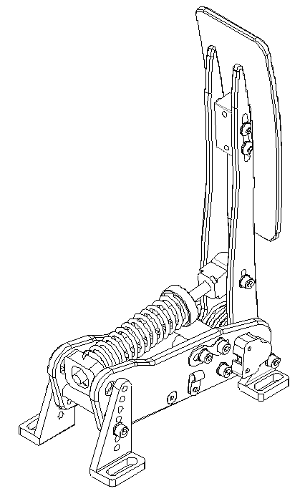
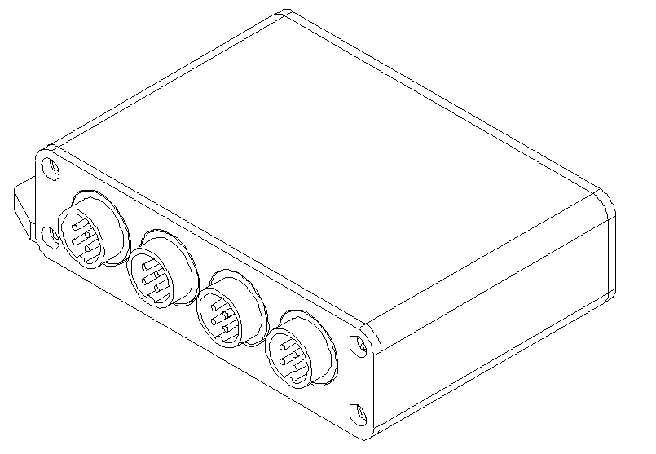
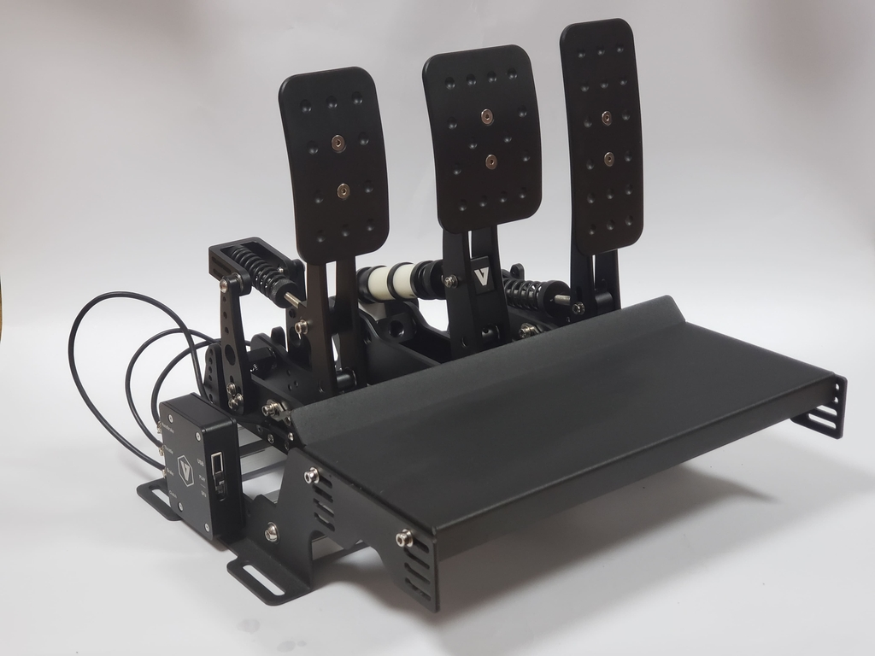
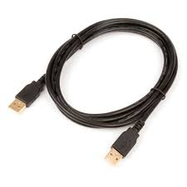
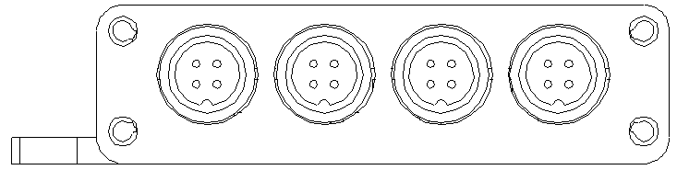
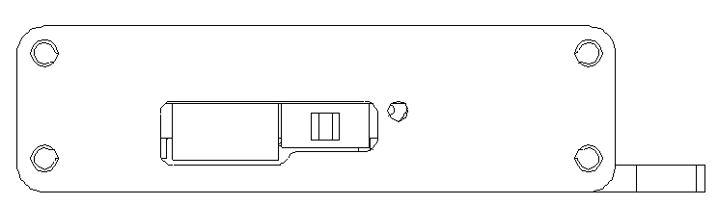
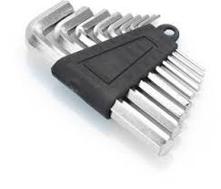

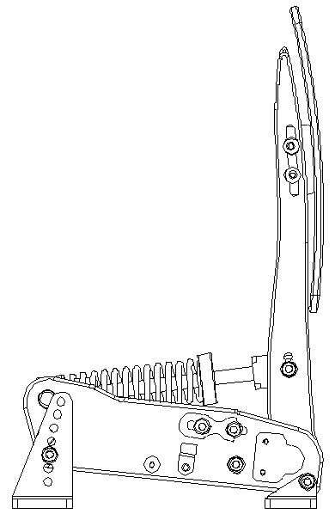
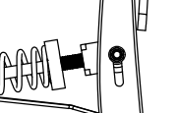
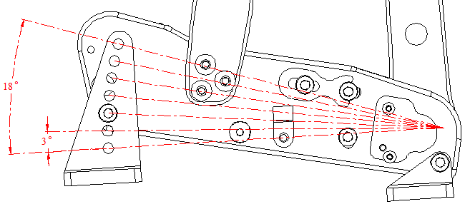
VNM PEDAL
Quick Guide
Content
Connection
4
On the left side of the VNM Controller Box is:
1. Handbrake 3. Brake
2. Throttle 4. Clutch
Plug in the GX12 ports for signal connection.
1
2
3
1
2
5
3
On the right side of the VNM Controller Box is:
5. Switch DFU/Game Mode
Slide left side to select DFU Mode or right side to select Game Mode.
6. Plug in USB cable to connect to PC.
6
5
4
1. VNM Throttle
2. VNM Brake
3. VNM Clutch
4. VNM Controller Box
5. USB Cable
6. Allen key set
7. Steel springs
6
7
Adjust Pedal
1. Adjust the height of the Pedal face
2. Adjust the Pedal tilt angle
3. Adjust the Pedal Force
Here we give 7 options so you can change the angle of the pedal to your liking.
Remove the 2 hex bolts on the sides, then choose the angle that suits you and tighten them with the hex bolts.
Loosen the 4 the hex bolts on the sides behind the pedal face, choose a suitable pedal height, then tighten.
Adjust the spring preload so that the pedal force is right for your foot
In addition, you can also change the force by adjusting the position of the screw here

Slide 2
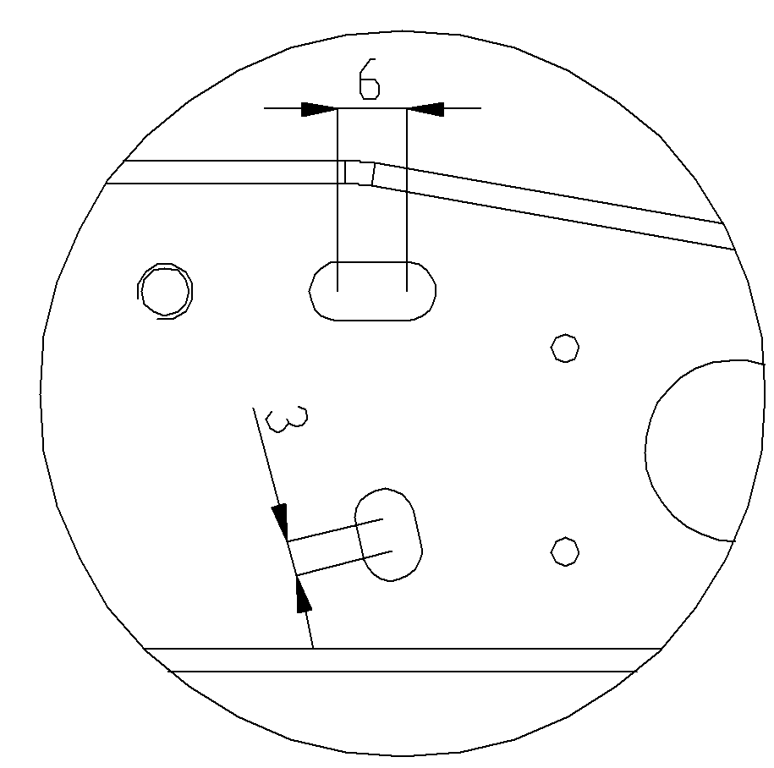
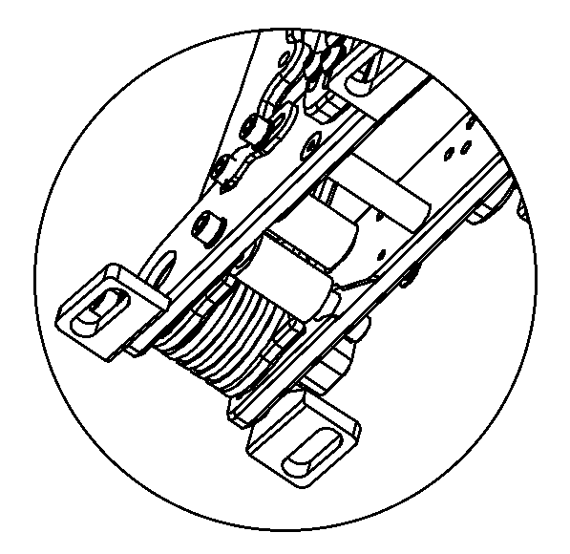
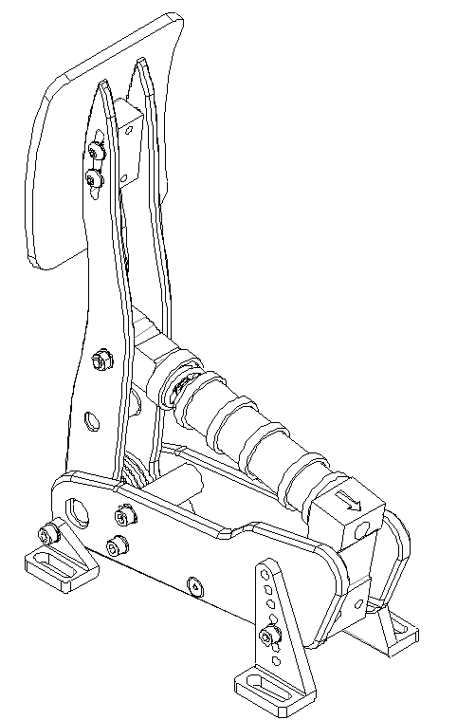
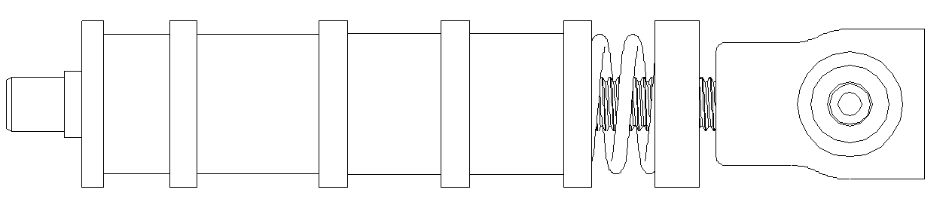
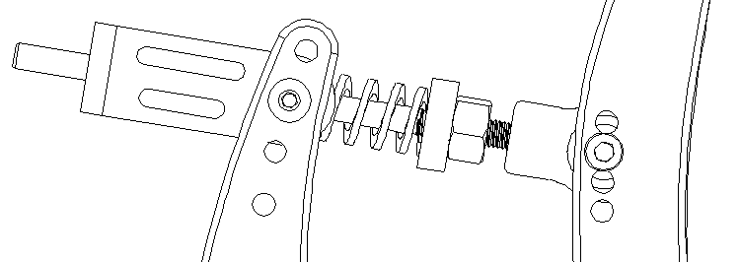
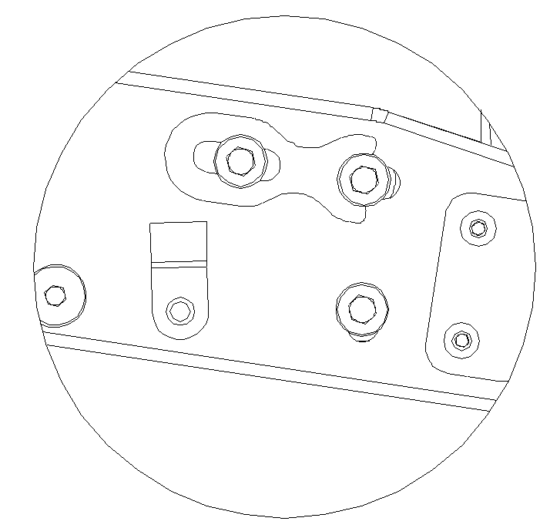
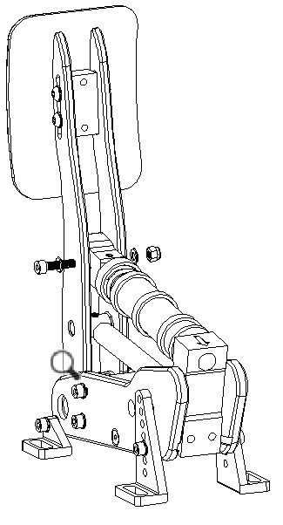
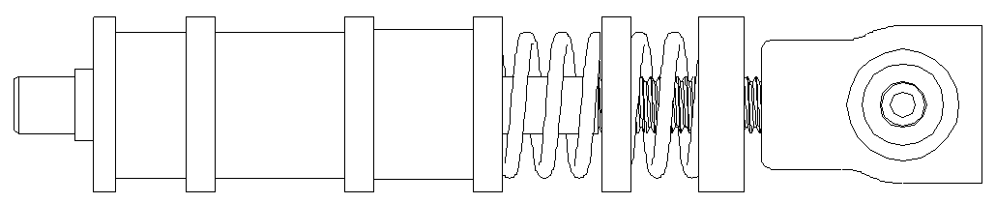
4. Adjust the Pedal Journeys
5. Exchange Spring & Elastomer
Loosen the 2 hex bolts on the sides, adjust 2 blue bumpstops to change pedal stroke
Step 1: Remove the elastomer stack
Blue Bumpstop 1:
Move blue bombstop to change pedal stroke limit.
Blue Bumpstop 2:
Adjust the inclination of the pedal face (pedal stroke start point)
1
max
min
Step 2: Choose a suitable combination of springs and elastomers
max
2
3 combinations are recommended, but feel free to mix and match to find the perfect combo for you.
min
Option 1: 2.5mm spring + 2 elastomers
Adjusting the Blue Bumpstop 1
Step 1: Remove spring assembly.
Step 2: Loosen the hex bolts 1 & 2 on the sides then choose the location of the blue bumpstop that works for you and tighten the hex bolts 2 you just loosened.
Step 3: Move the locating pin to fix the hex bolt 2 then tighten the hex bolt 1 (with VNM Throttle and VNM Clutch).
Step 4: Reinstall the spring assembly.
Remove bolts then remove spring assembly
Option 2: 3mm spring + 2 elastomers
Step 3: Re-install the elastomer stack
Reinstall the stack and adjust the preload to your liking.
1
Option 3: 2.5mm spring + 3mm spring + 1 elastomer
2

Slide 3
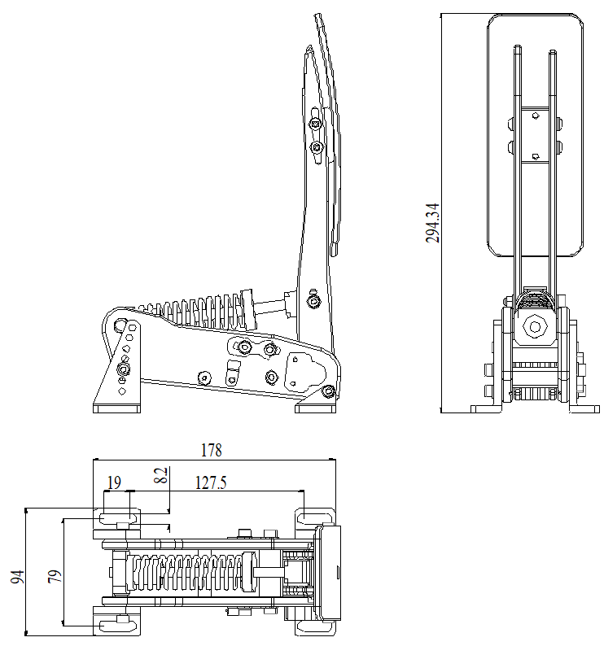
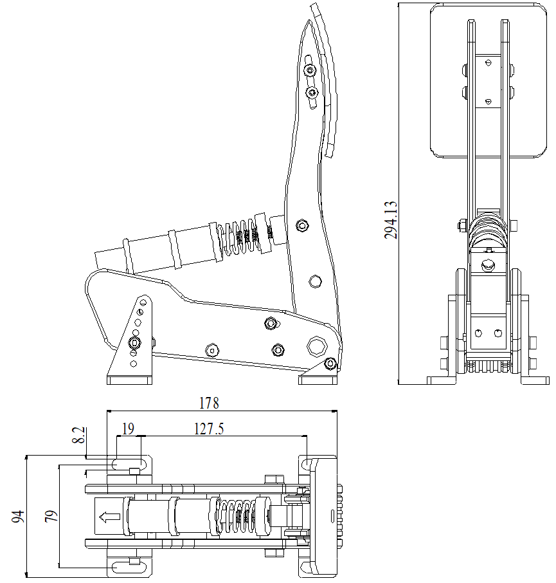

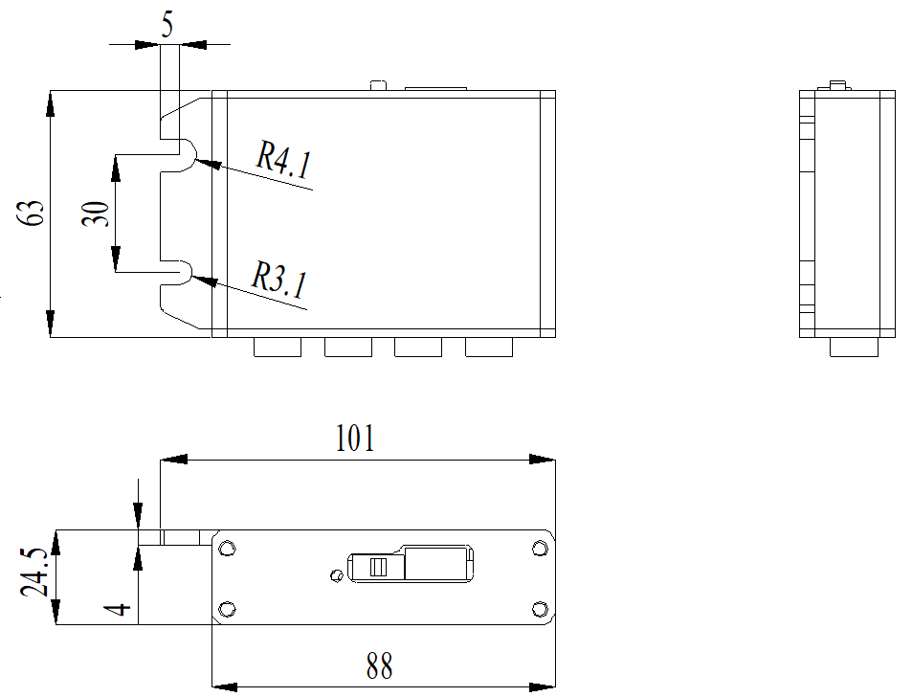
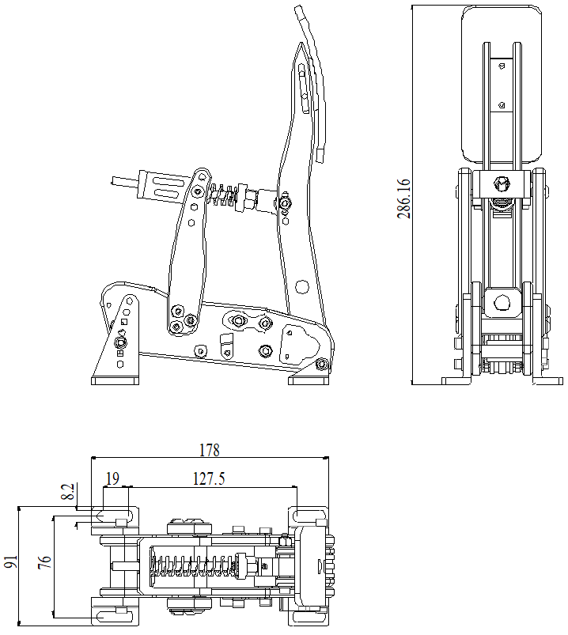
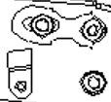
Mounting Drawing Throttle
Mounting Drawing Brake
Mounting Drawing Controller Box
Mounting Drawing Clutch

